Slide 1


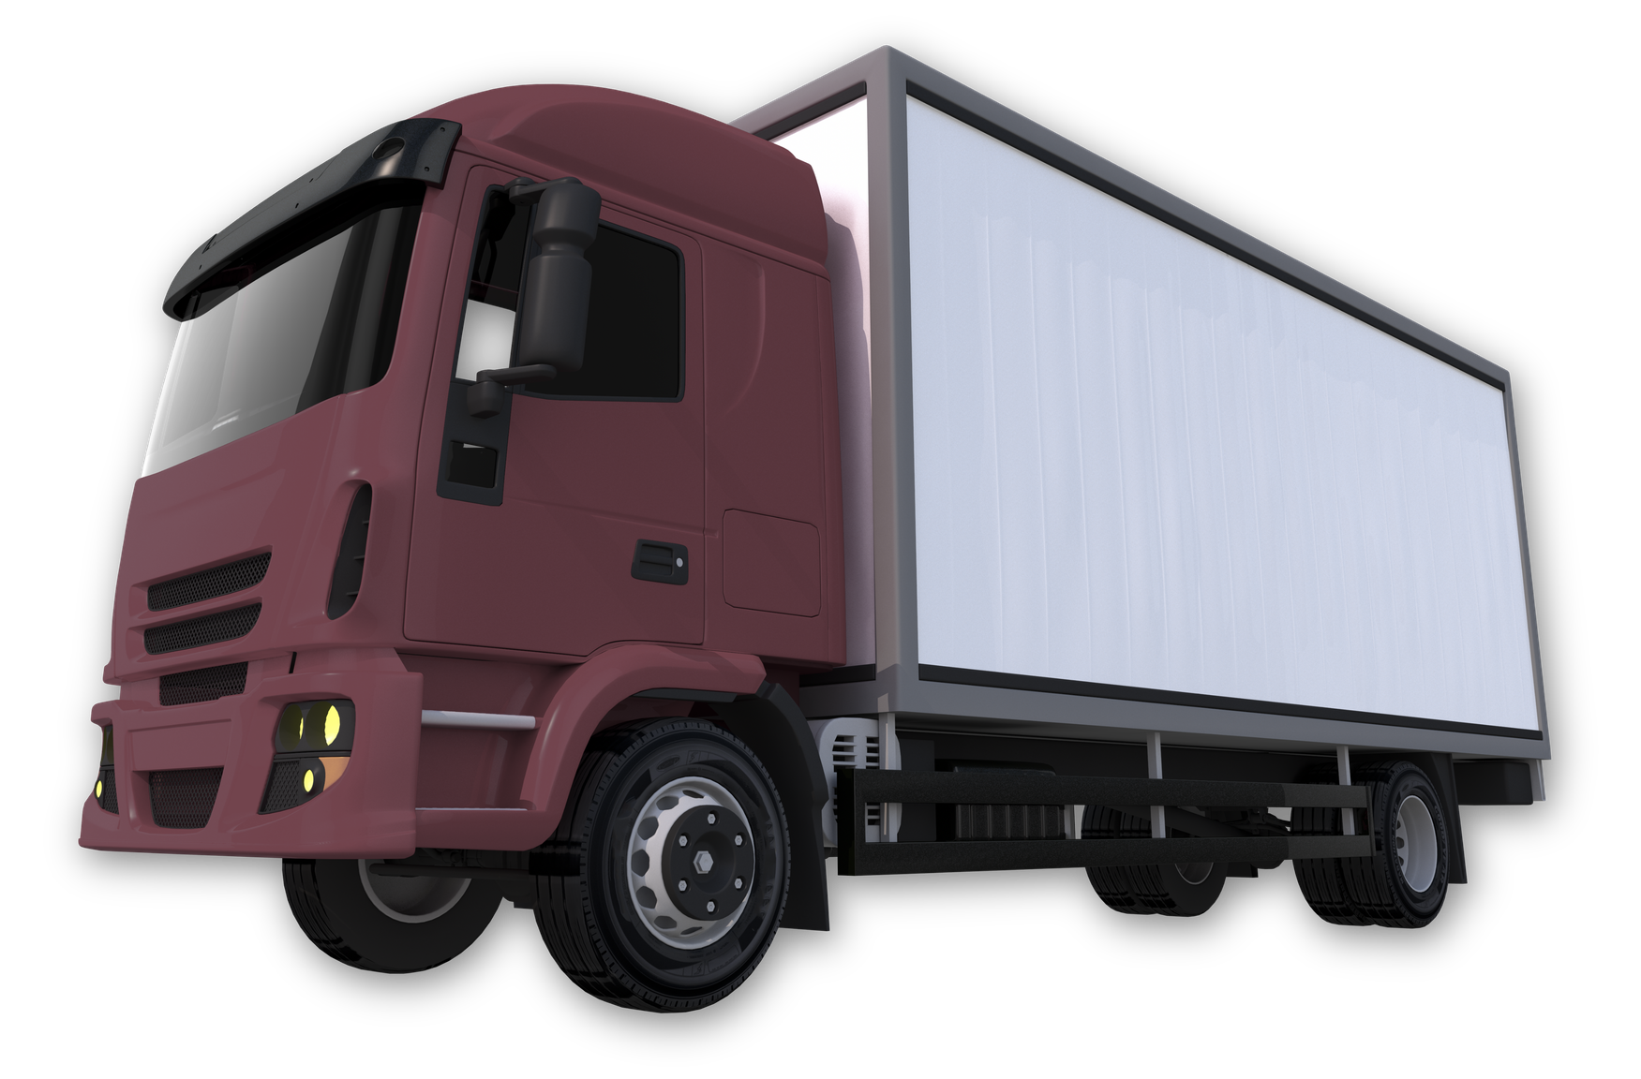


Digital Egypt Pioneers Initiative - DEPI Round 4, 2026
SWIFT HAUL
LOGISTICS ANALYSIS
Transforming Raw Data to Bridge the Gap: Where Precision Leads to CSAT
TRACK:
Data Analytics
PRESENTED BY:
CLS - CAI4 - DAT2 - S1 Team 3
MAJOR:
Microsoft Power BI Specialist
PRESENTED TO:
DEPI
INSTRUCTOR:
Mahmoud Seraj

Slide 2





WIFT HAUL COMPANY
OUR TEAM
Shimaa Samy
Jana Elnaggar
Mariam Hesham
Mariam Mowafy
Chemical Engineer
Ai Engineer
Financial Analyst
Financial Analyst
Fatma Elzahraa
Financial Analyst

Slide 3

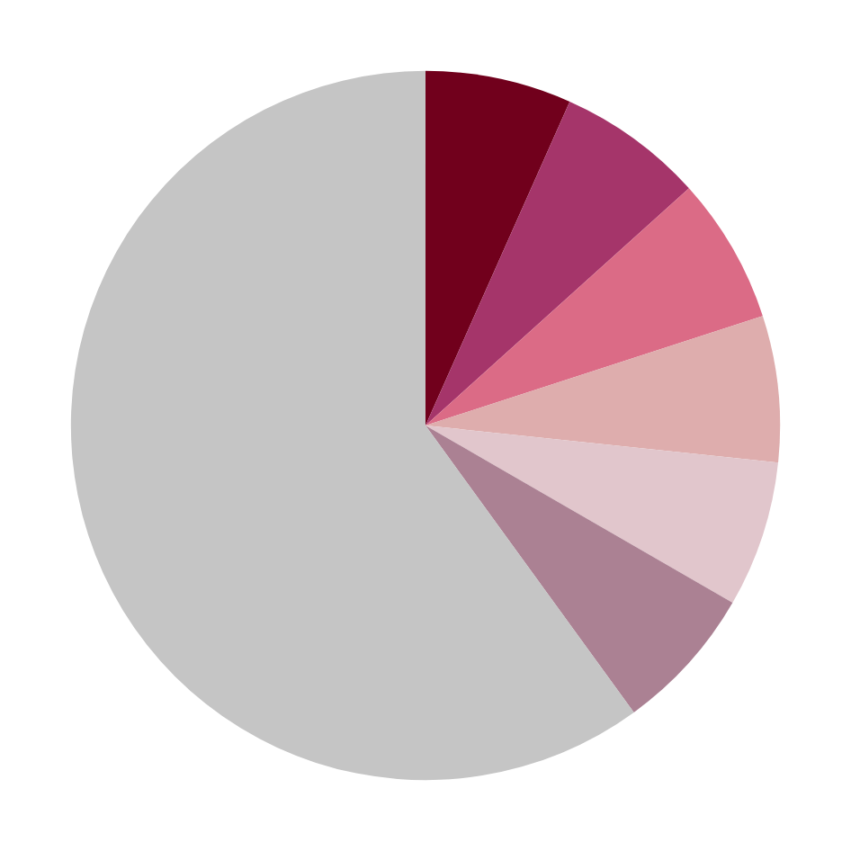




WIFT HAUL COMPANY
PROJECT OVERVIEW
ROADMAP
DATA & METHODOLOGY
Agenda
KEY PERFORMANCE INDICATOR
DASHBOARD ANALYSIS & INSIGHTS
RECOMMENDATIONS

Slide 4






Project Overview
Our project addresses inefficiencies in logistics operations and helps identify key factors affecting delivery performance.
It analyzes orders, drivers, vehicles, and hubs to improve efficiency and enhance customer satisfaction.
Our scope
Orders Flow
Driver Performance
Hub Efficiency
Customer Satisfaction
Vehicle Usage
Shows how orders move from placement to delivery and helps identify demand trends and peak periods for better planning.
Evaluates drivers based on experience, ratings, and delays to improve efficiency and service quality.
Analyzes how vehicles are used and which types handle more orders to optimize fleet performance.
Measures how efficiently hubs process orders compared to their capacity, helping reduce overload and improve distribution.
Reflects customer experience and is directly affected by delivery time and service quality.

Slide 5








Vision to Execution Roadmap
Data Cleaning
Data Visualization
Convert vision into actionable and specific organizational goals.
Created visual reports and KPI tracking to monitor logistics performance.
Data Collection
Exploratory Data Analysis (EDA)
Insights & Reporting
Collecting logistics data from multiple sources including orders, drivers, vehicles, and hubs to build a complete dataset for analysis.
Designed interactive Power BI dashboards to monitor logistics performance and support data-driven decision making.
Tools Used; Power BI, Power Query and DAX query.
Analyzed trends, delivery patterns, and operational performance indicators.

Slide 6

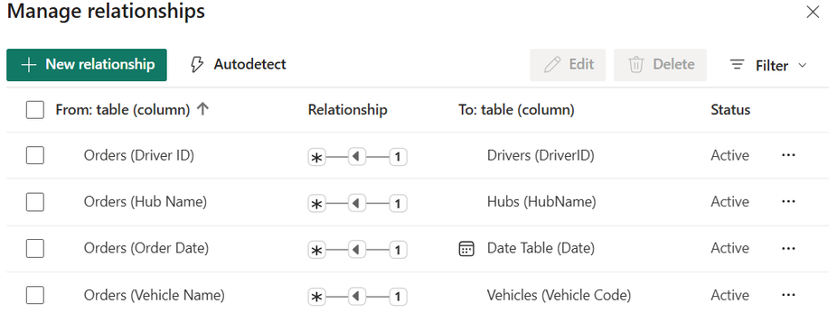

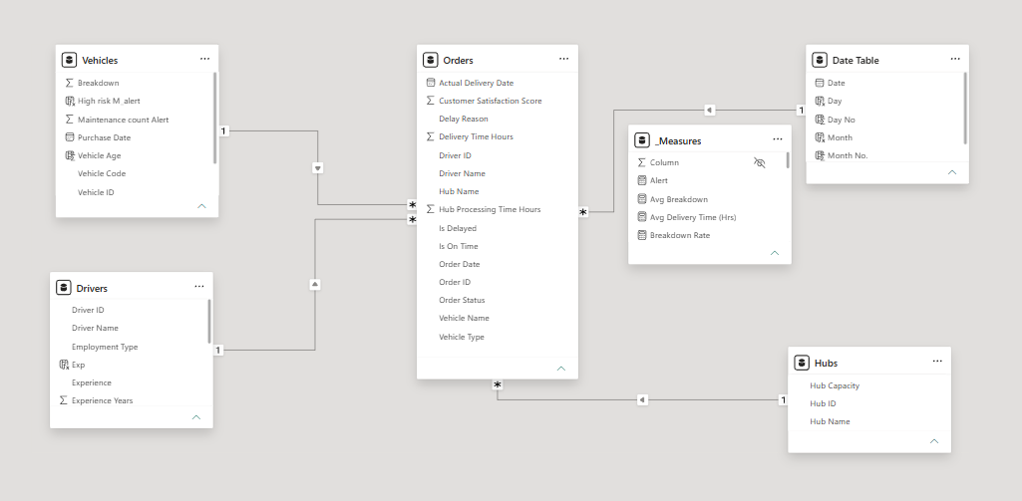

Data & Methodology
The project followed an end-to-end analytics workflow
Integrated multiple logistics-related tables into a unified data model
Established relationships between orders, drivers, vehicles, hubs, and date tables
Created calculated measures and KPIs using DAX formulas
Applied data modeling techniques to improve reporting performance
Designed scalable and interactive dashboards for operational analysis

Slide 7
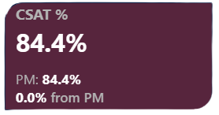
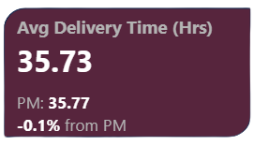
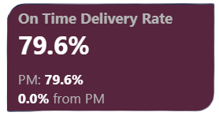


Key Performance Indicators
We developed key performance indicators to measure logistics efficiency and monitor operational performance.
Orders Flow
Measures customer satisfaction with the delivery service and helps identify the impact of delays on customer experience.
Tracks the average time required to complete deliveries and helps evaluate operational efficiency, delivery speed, and potential delays in the logistics process.
Shows the percentage of orders delivered on schedule and reflects delivery reliability, service efficiency, and the company’s ability to meet customer expectations.
Represents the total number of processed delivery orders and provides insight into operational workload, delivery demand, and overall business activity.
Orders Flow
Orders Flow

Slide 8

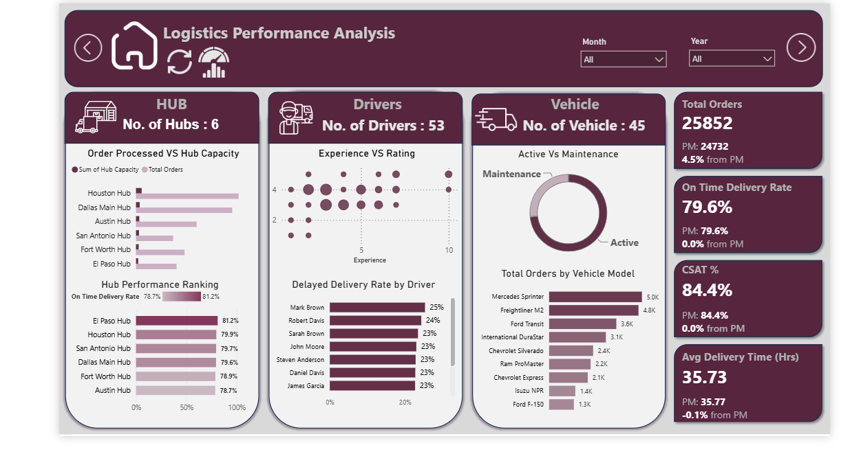


Dashboard Analysis & Insights
Overall view of logistics operations performance
The dashboard shows a total of 25852 processed orders during the selected period.
On-time delivery rate reached 79.6%, which reflects overall delivery performance and operational efficiency.
Customer satisfaction scored 84.4%, indicating generally positive customer experience.
Vehicle maintenance represented 26.67% of the fleet status, highlighting the importance of maintenance management.
Houston Hub processed the highest number of orders compared to other hubs.
Some drivers recorded higher delayed delivery rates, helping identify performance gaps.
WIFT HAUL COMPANY

Slide 9
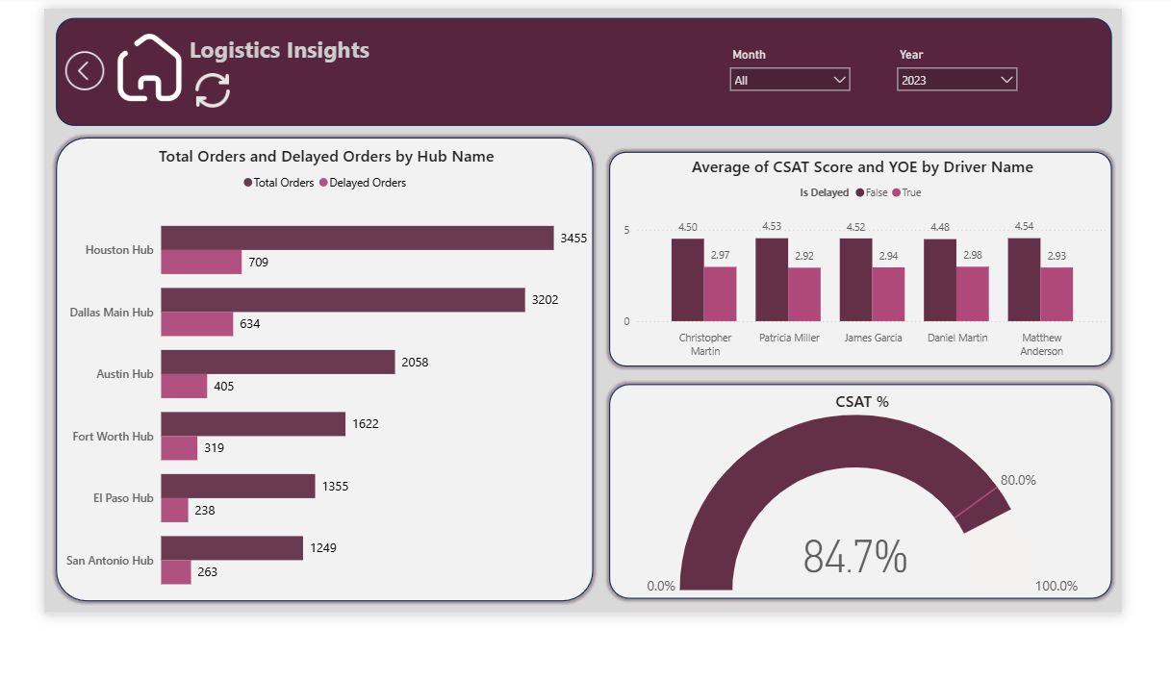
Dashboard Analysis & Insights
Analyzes delivery performance and customer satisfaction across hubs and drivers.
Dallas Main Hub recorded the highest total and delayed orders among all hubs.
Customer satisfaction scores decreased when deliveries were delayed.
Some drivers maintained higher satisfaction scores despite operational challenges.
The overall CSAT score reached 84.7%, indicating a generally positive customer experience.
Delayed orders varied significantly across hubs, highlighting operational performance differences.
WIFT HAUL COMPANY

Slide 10
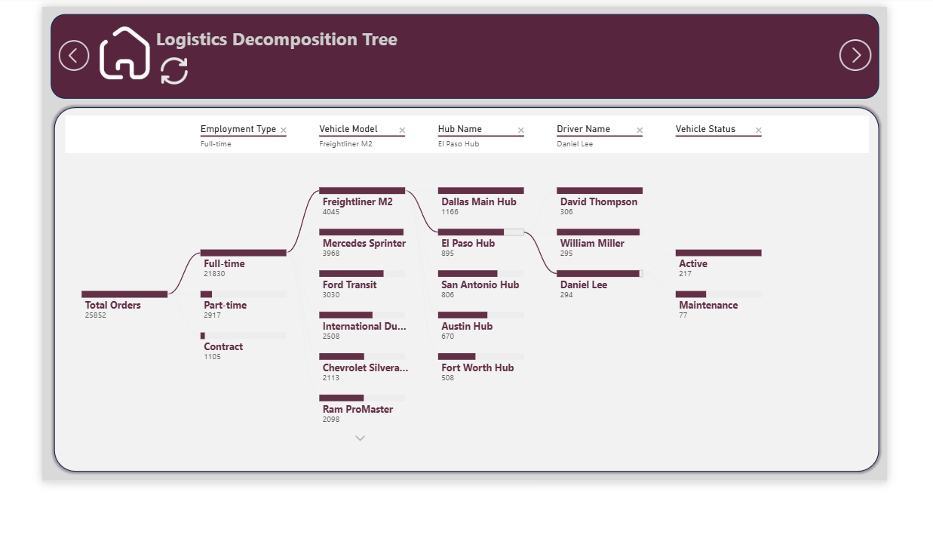
Dashboard Analysis & Insights
Analyzes order distribution and operational performance across drivers, hubs, and vehicle models.
Full-time drivers handled the majority of total orders compared to part-time and contract drivers.
Freightliner M2 recorded the highest number of processed orders among vehicle models.
El Paso Hub showed strong operational contribution within the selected analysis path.
Driver Daniel Lee handled the lowest number of orders under the selected filters.
WIFT HAUL COMPANY

Slide 11





Recommendations
Identify Segment
What we found:
Some hubs, such as Houston Hub, handled significantly higher order volumes compared to other hubs.
What we recommended:
Redistrivute workload to lower-pressure hubs like El Paso and San Antonio.
This could improve operational efficiency and increase on-time delivery rates.
Improve Preventive Maintenance
Focus on Delivery Performance Metrics
What we found:
Vehicle Breakdowns were one of the main causes of delayed deliveries.
What we recommended:
Strengthen preventive maintenance.
Monitor vehicle condition regularly
Improve delivery reliability
What we found:
Driver experience years showed little impact on actual performance.
What we recommended:
Focus more on operational KPIs such as On-Time Delivery Rate, delay count, and customer satisfaction scores.
Step
02
Step
Step
01
03

Slide 12

Recommendations
Prepare for Peak Demand Periods
What we found:
High-order periods may negatively affect delivery performance and customer satisfaction.
What we recommended:
Plan additional driver availability
Ensure vehicle readiness during peak months.
Optimize Fleet Utilization
Enhance Customer Experience
What we found:
Certain vehicle models experienced higher breakdown rates and delivery days
What we recommended:
Monitor vehicle performance
Replace high-risk vehicles
This can improve fleet efficiency and reduce operational interruptions
What we found:
Delayed deliveries were associated with lower customer satisfaction scores.
What we recommended:
Reduce Delivery times.
Improve Operational Response.
This can improve customer experience and CSAT ratings.
Step
05
Step
Step
04
06

Slide 13

WIFT HAUL COMPANY
ANY
QUESTIONS

Slide 14

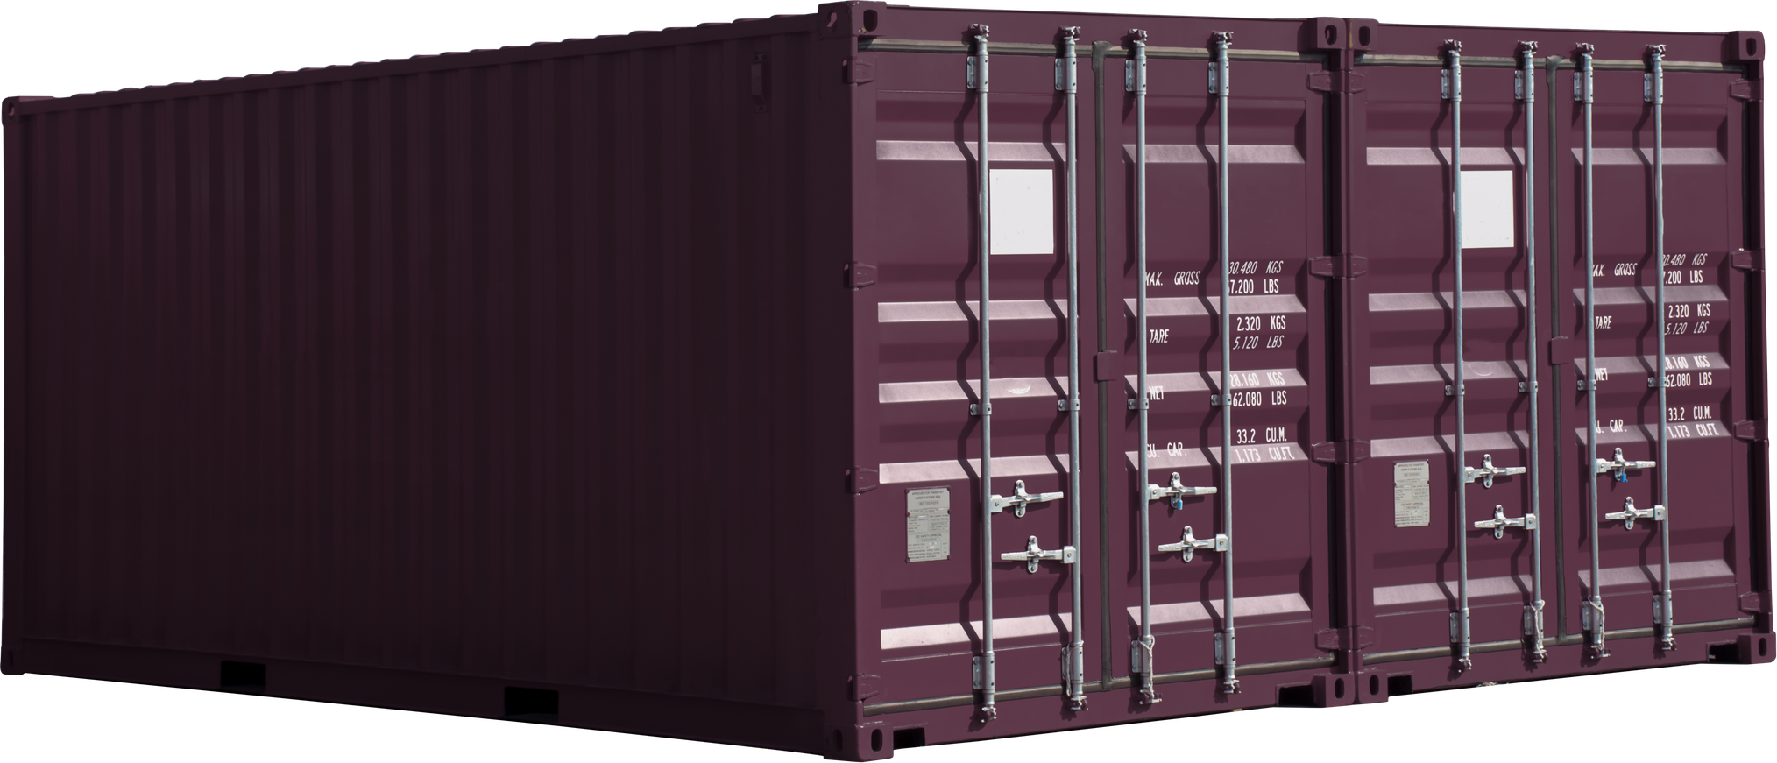

WIFT HAUL COMPANY
THANK YOU
END SLIDE

